Slide 1
NUMBER GUESSING GAME
Project Presentation of MINI PROJECT
Presented To : Presented By :
MADHAV SINGH
HARSH VARDAN SINGH

Slide 2
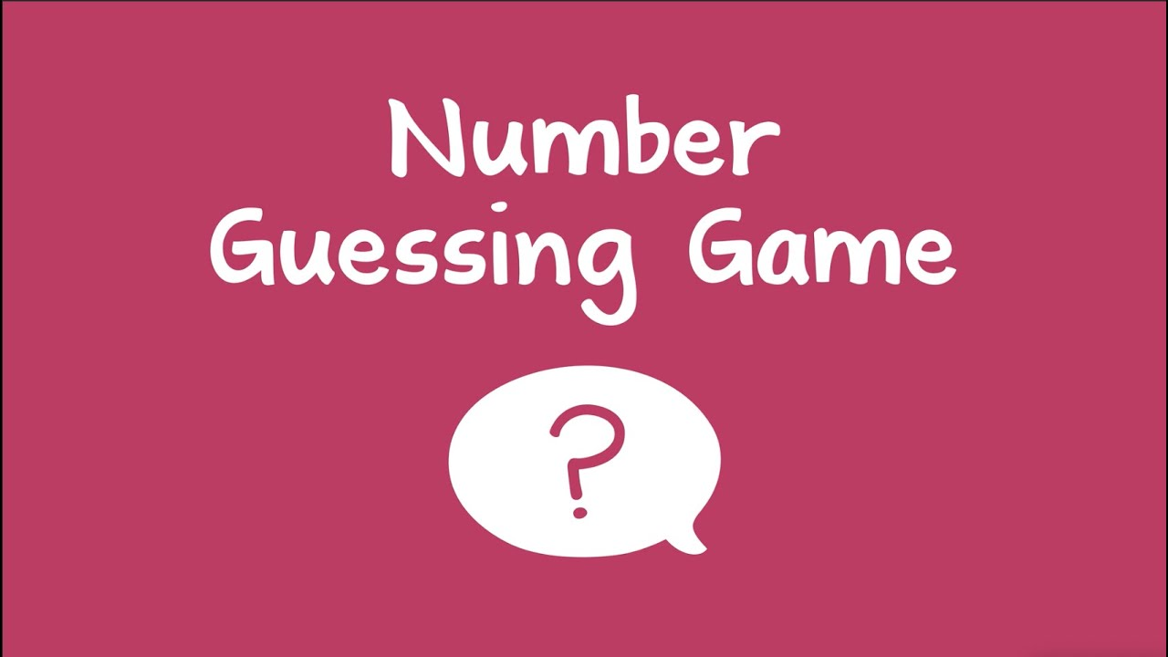
Table of Content
Introduction
Problem Statement
Aims and Objectives
Methodology of Research
Result Expected
Utilization of Research
Work Progress
References

Slide 3
INTRODUCTION
We shall use a random method to generate a random number. The computer asks the user for a guess ,the user types a number. If the user’s number is less than a system than the computer print a message that the number is low and asks for a higher number and vice-versa.
If the user number is match with computer’s number than the computer prints a message “Congratulating the user” and the game will end.

Slide 4
PROBLEM STATEMENT
In this game, the programmer set a no. which is generated by system and then the user will keep making guesses of what the number of system and the user is not match but in given chances. We continue the loop until the user correctly guesses the no. Ask the user to correct guess the number. He can play as many times as he wants.

Slide 5
AIMS AND OBJECTIVES
The goal of this assignment is to learn the following:
Conditional and lexical scoping
Loops
Analyze the problem statement
Learn to create a user Interface with the help of Python.

Slide 6
Methodology of Research
We will combine theory as well as practical (coding).
Basically, we take all the values and figure out all the possible combos of them (we done this part). Then we take all the possible combos and put them in a database as a dictionary entry. We do this each time and we get a new no. So we have all list of all possibilities. So due to this user get a different no. So it will create a interest.

Slide 7
Some functions usages to build this game. random.randint (1,100) // used to generate the random numbers by the user. chances.set () // to set the chances in the game by the programmer. result.set () // this is used whether the user win or lose the game .It displays on the screen. if -else condition // Used to set the probability in the game whether we guess low , high or equal to guess the number.

Slide 8
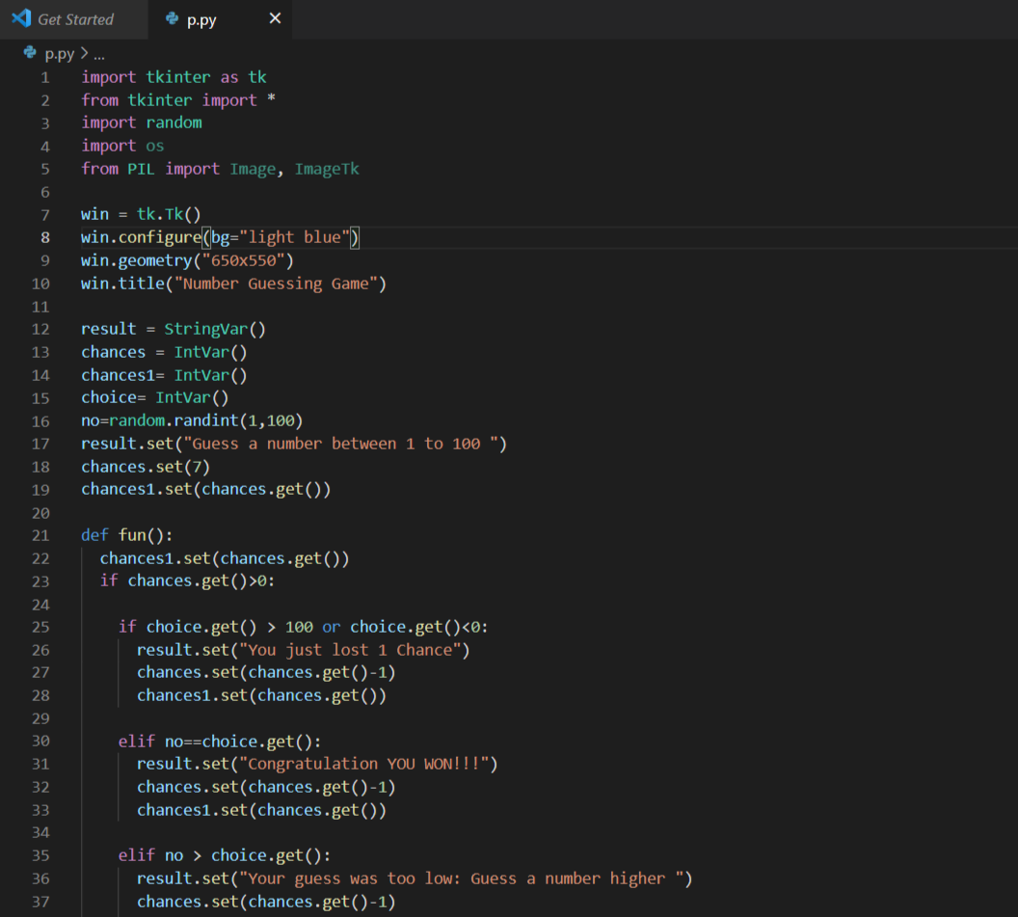
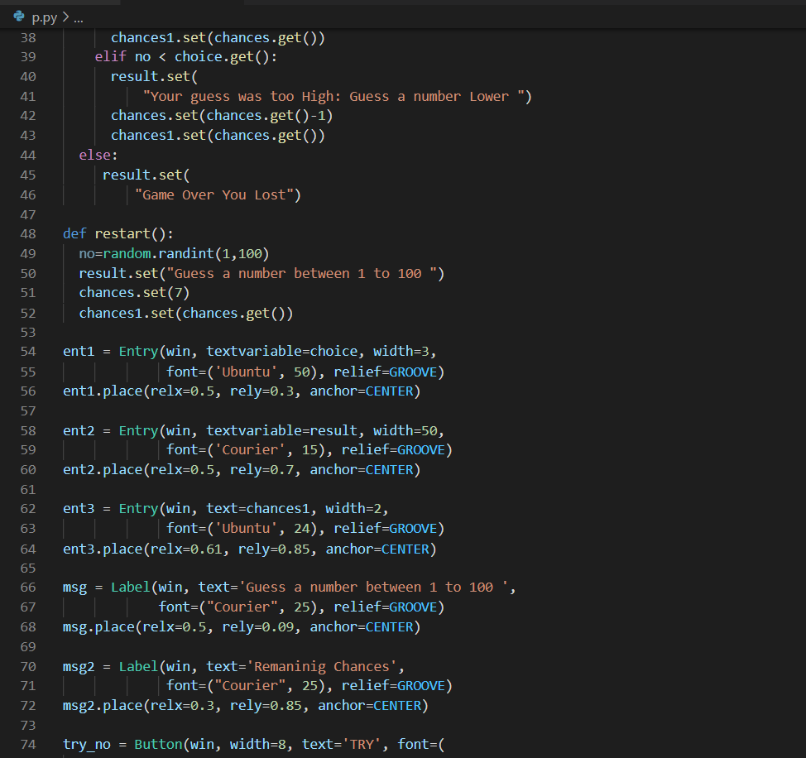

Slide 9
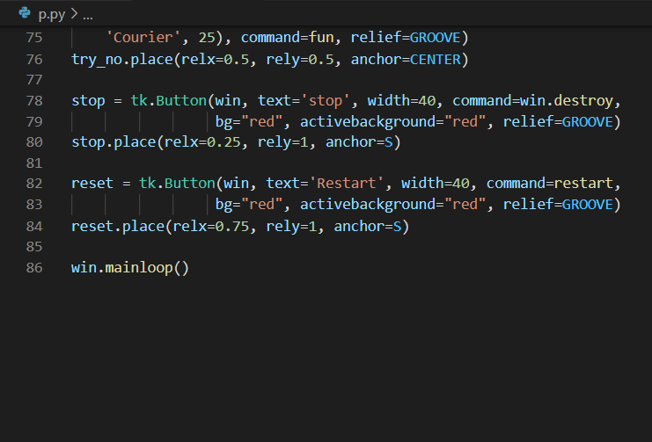

Slide 10
RESULT EXPECTED
In the top of the interface we have a statement Guess a Number between 1 to 100.
We have a box in which user can guess a number and user hit the try button for their guess.
After that we have a box which tell us about the remaining chances to guess the correct number.
At the end we have two buttons that are ‘STOP’ – to stop the game and ‘RESTART’- to restart the game.

Slide 11
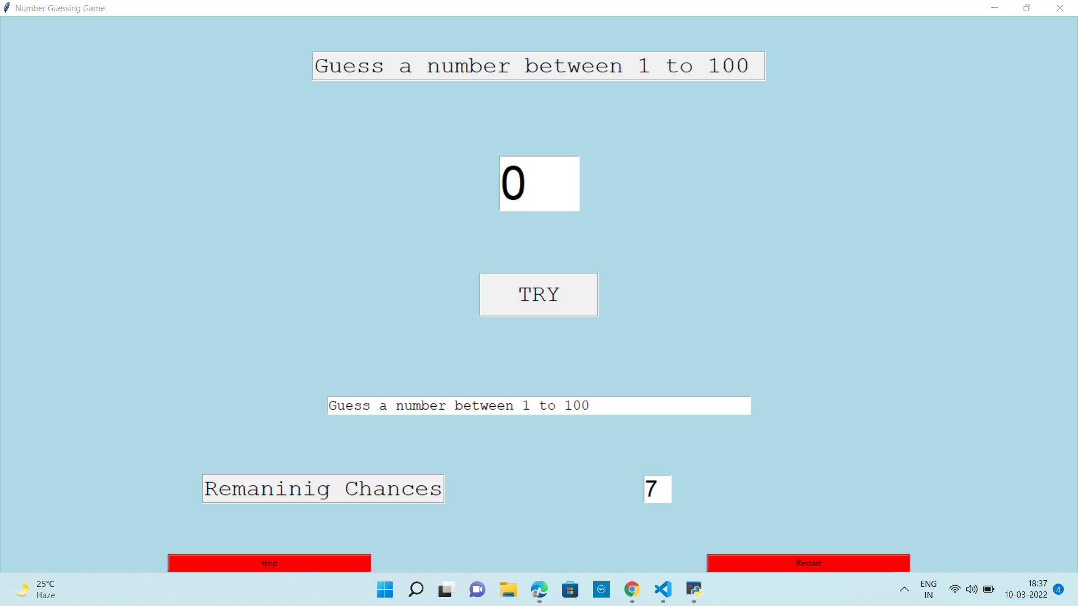

Slide 12
UTILIZATION OF RESEARCH
The proposed system has to be examined for its technical, economical and operational feasibility. It is evaluated from developer and user’s point of view. Feasibility study includes consideration of all the possible ways to provide a solution to the given problems. The proposed solution should satisfy all the user requirements and should be flexible enough so that the future changes can be easily done based on the future upcoming requirements.

Slide 13
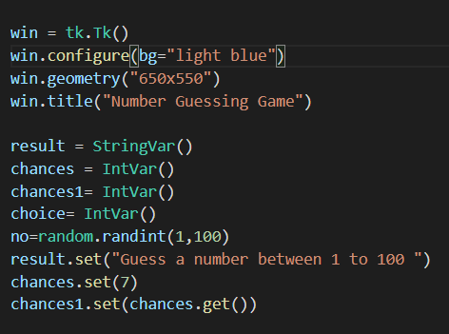
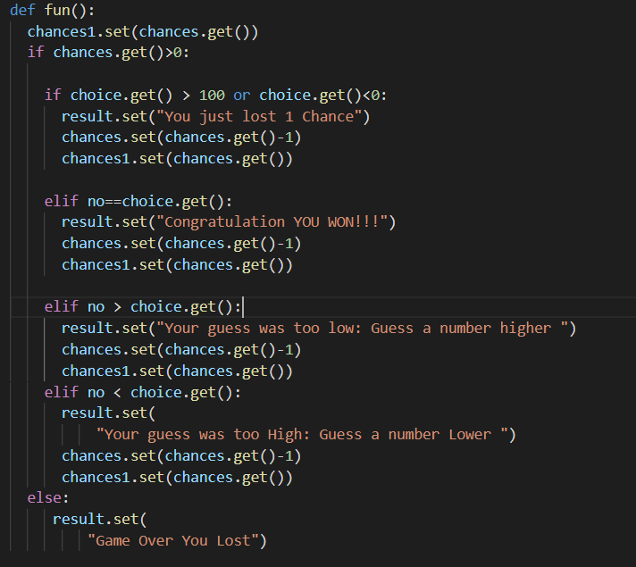
WORK PROGRESS

Slide 14
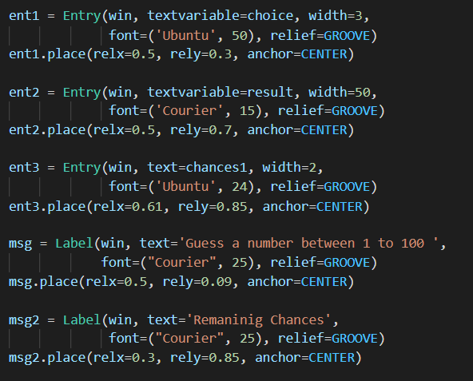
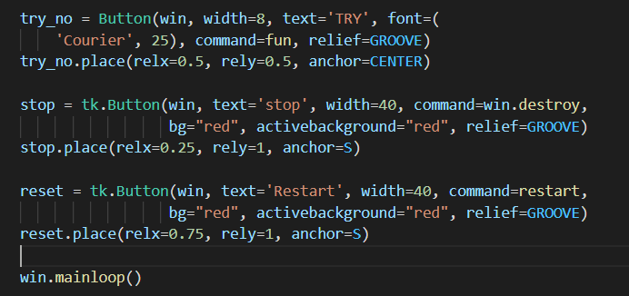

Slide 15
REFERENCES
www.geeksforgeeks.org
www.wikipedia.org
www.academia.edu
www.github.com
www.coursehero.com
www.protectnotes.org
https://www.codewithharry.com/

